Slide 1
Summary Proposal
EPPN Project: Bigger, better Brassica: does induced polyploidy increase yield?

Slide 2
Research questions
Test hypothesis that polyploids are larger, more vigorous and produce more biomass than their corresponding diploid progenitor species in a system which allows separation of the effects of
heterozygosity,
ploidy level increase and
genomic instability.
How do polyploidy and hybridization affect
biomass accumulation
plant biomass at flowering,
growth rate up until first flower
Fertility
number of siliques,
number of filled siliques,
number of seeds per silique and
number of seeds produced under self-pollination conditions per plant

Slide 3
Proposed advantages of Polyploidy
gene redundancy
Increased tolerance for novel mutations
Potential for diversification of gene functions
Heterosis or “hybrid vigour”
hybrids between distant relatives: Presence of two different alleles at individual genomic loci, which is more likely in hybrids between distant relatives, can cause dominance or overdominance effects that result in increased biomass, stature, growth rate, fertility levels and/or stress tolerance of the hybrid.
Polyploid species: Polyploid species can potentially benefit from so-called “fixed heterosis”, whereby alleles within different subgenomes can be homozygous, but differ to the corresponding allele copies at homoeologous gene loci, resulting in inter-homoeologue heterozygosity that persists across generations of self-pollination.
larger cell and organ size

Slide 4
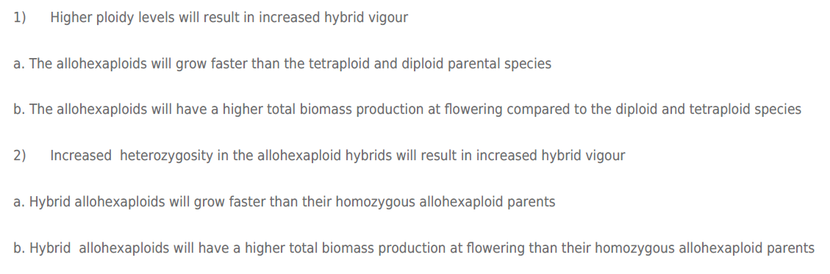
Hypotheses

Slide 5
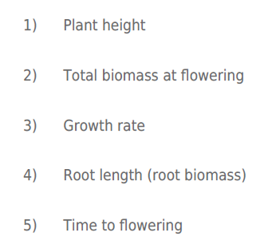
Traits to be measured

Slide 6
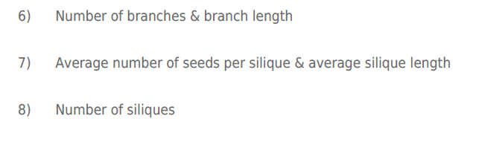
Post-harvest estimated total seed set including

Slide 7
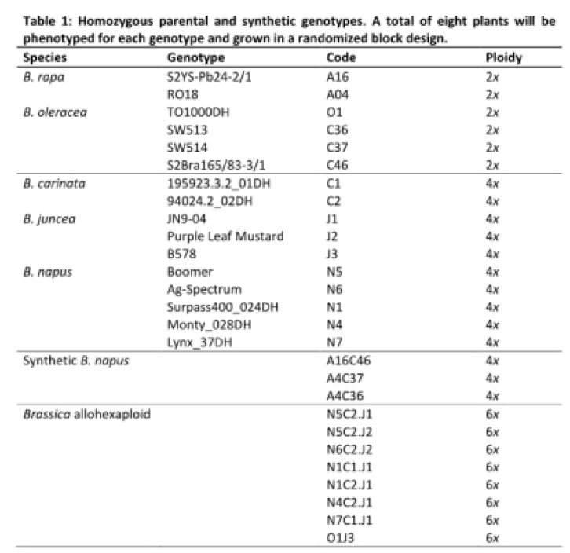
Plant Material

Slide 8
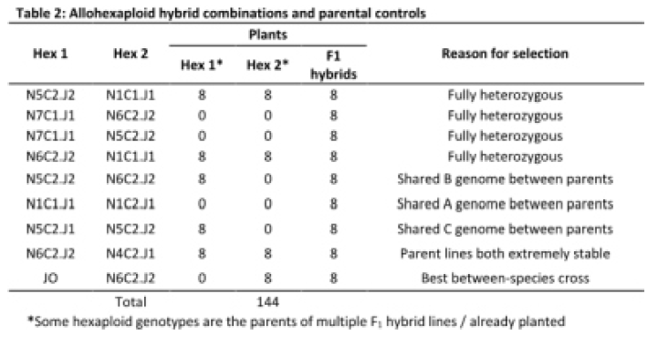
Allohexaploids

Slide 9
Is increased heterosis (= better performance of the hybrids relative to their parents) the primary factor in the observed “polyploidy advantage”?
Effects of heterozygosity and ploidy level need to be separated
We have produced interspecific hybrids at the allotetraploid and allohexaploid level from homozygous parental lines, thus avoiding confounding effects of allelic diversity.
In Allotetraploids two different sets of alleles contribute to phenotypic traits, while allohexaploids three different sets of alleles contribute.

Slide 10
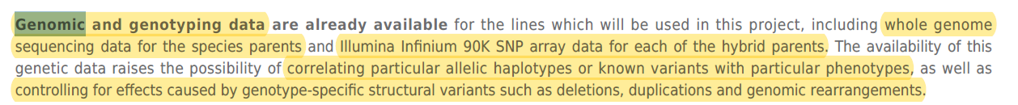
Available genomic and genotyping data
whole genome sequencing data for the species parents
Illumina Infinium 90K SNP array data for each of the hybrid parents
Goals:
correlate particular allelic haplotypes or known variants with particular phenotypes
control for effects caused by genotype-specific structural variants (eg deletions, duplications and genomic rearrangements)

Slide 11
Deep learning pipeline
designed for quantifying Arabidopsis pods
will be retrained on harvested Brassica stems and related to pre-harvest images of plants as well as hand-collected fertility data.
This data will allow
quantification of the effects of ploidy increase and heterozygosity at higher ploidy levels
interrogation of the trade-off between biomass production and seed yield in these Brassica oilseed crop types.

Slide 12
Summary Report

Slide 13
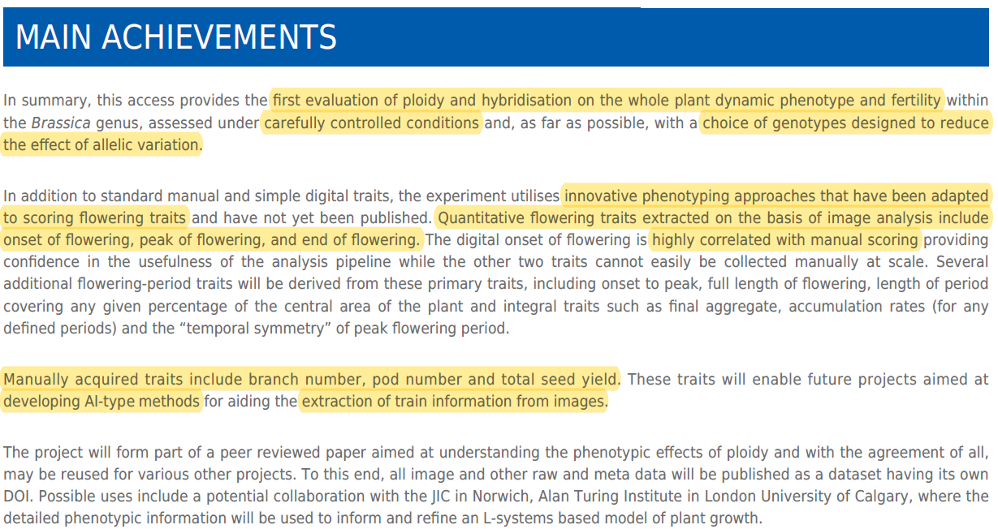

Slide 14
No publications?

